Slide 1
CRASH Predictive Analytics: Using Machine Learning to Improve Highway Safety
Sayyed Mohsen Vazirizade, Geoffrey Pettet, Ayan Mukhopadyay,
PIs: Hiba Baroud, Abhishek Dubey
Vanderbilt University
In Collaboration with Said El Said, John Hall, Ray and Brad Freeze and Others at Tennessee Department of Transportation

Slide 2
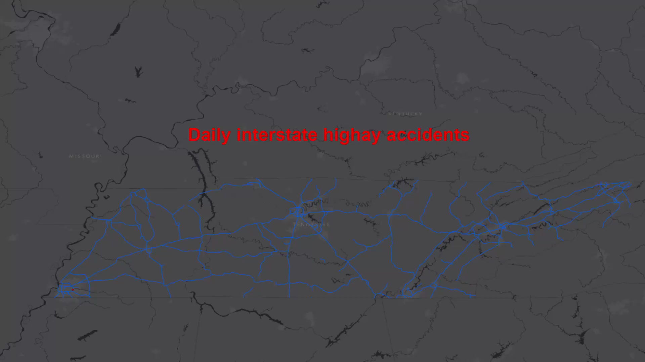

Slide 3

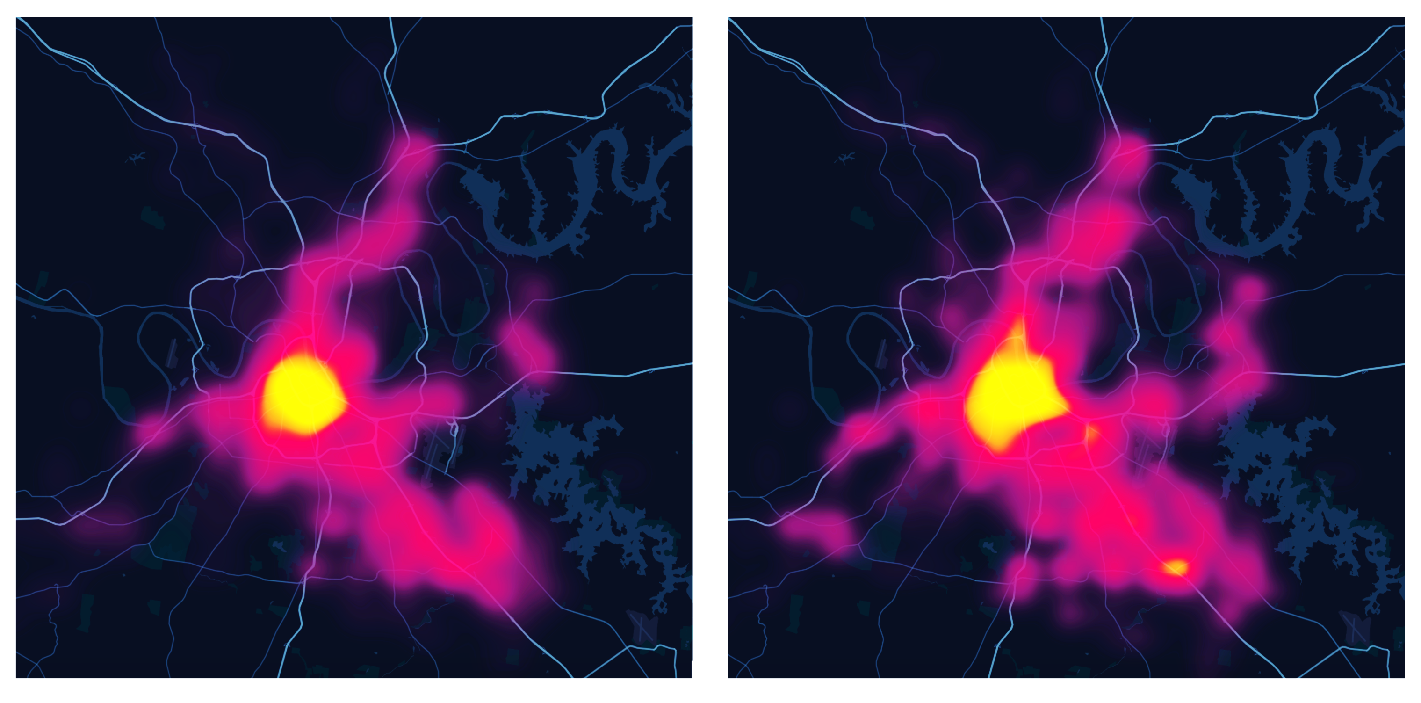

Key Idea: Proactive Emergency Response
Active Learning and Improvement Mechanisms
Online Demand Estimation Models^{[1]}
Anticipatory Stationing of Resources
Optimal Dispatch^{[1]}
[1]
Prediction
Actual
Tree Search (MCTS)
https://statresp.ai

Slide 4
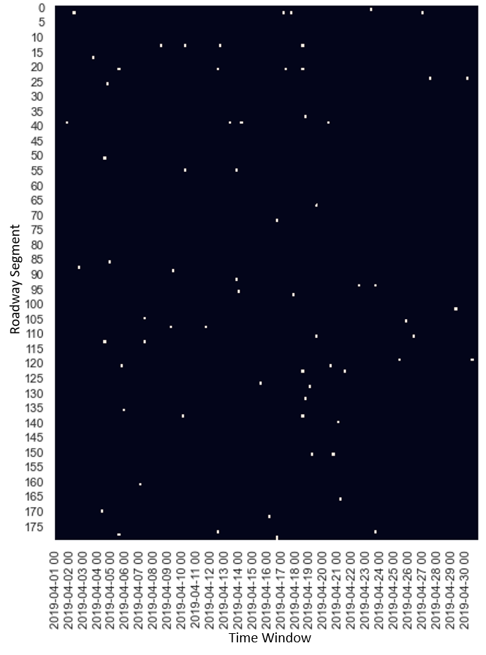
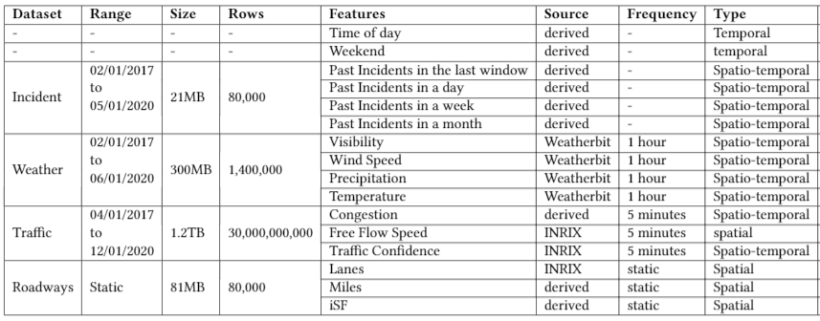
Challenges
Data Collection: Many factors are involved in road accidents, which requires collecting various types of data from assorted resources with different resolution and quality.
Sparsity: Although frequency of road accidents is high, when viewed from the perspective of total time and space, incidents are rare events.
Irregular incident occurrence: Accidents are random in nature, especially in high spatial-temporal resolution

Slide 5
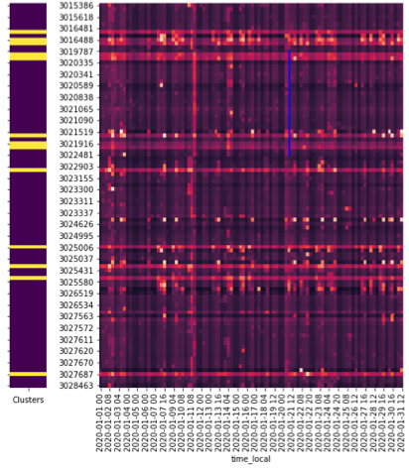
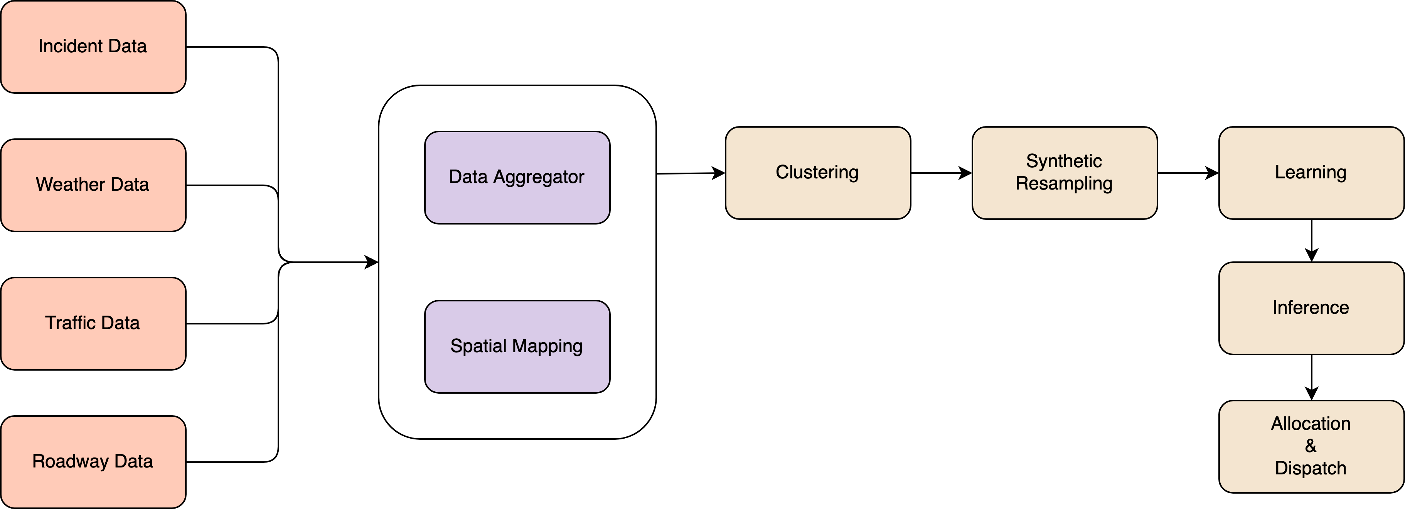
Our approach
The goal is designing a function, 𝑓 (𝑋 | 𝑤, 𝜃), where 𝑋 represents a measure of incident occurrence such as a count or presence of incidents during a specific time period. 𝜃 represents the parameters regarding the model.

Slide 6
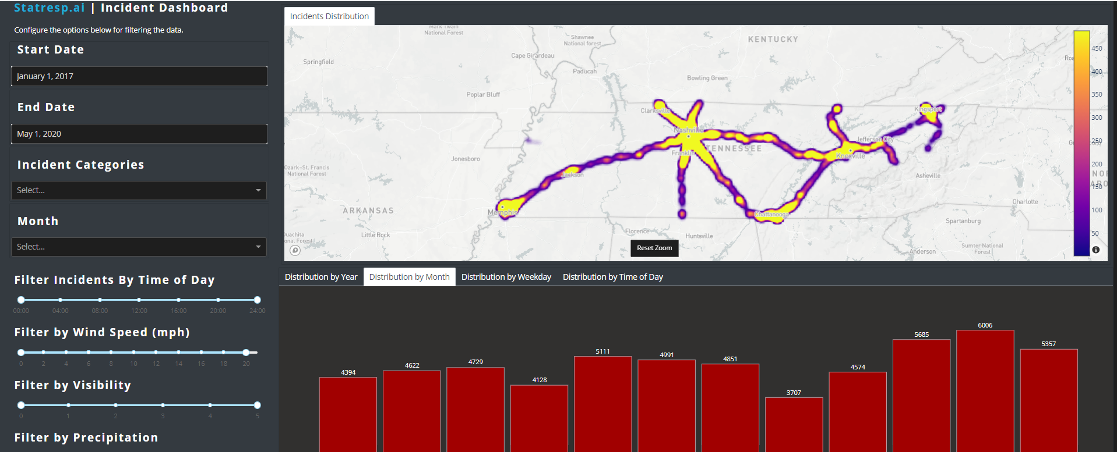
Dashboard

Slide 7
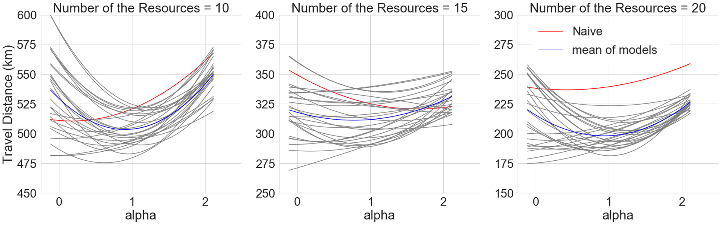
Evaluation
We evaluate our models using a modified p-median based allocation heuristics.
The objective of the standard p-median problem is to locate 𝑝 facilities(i.e. responders) such that the average demand-weighted distance between edges and their nearest facility is minimized.
We added a balancing called 𝛼. As it increases responders (green dots ) are tightly packed around high demand areas (red).
The effect of increasing alpha. Our experiment show that 0.5≤𝛼≤1 provides best results and reduces overall travel distance.

Slide 8
Prediction and Allocation Results
Different modeling paradigm (Logistic regression, neural network, random forest, Zero inflated Poisson) and parameters (𝛼 – concentration and p - # responders) were explored. Existing work use hotspot analysis which fails in such sparse datasets.
Green Cells show best performance.
Note the classical accuracy measure is not the best metric for evaluation due to sparsity and class imbalance

Slide 9
Key Publications
Vazirizade et.al. Learning Incident Prediction Models Over Large Geographical Areas for Emergency Response Systems. Submitted to KDD 2021
Yasas Senarath, Saideep Nannapaneni, Hemant Purohit, and Abhishek Dubey. Emergency Incident Detection from Crowdsourced Waze Data using Bayesian Information Fusion . IEEE/WIC/ACM International Joint Conference On Web Intelligence And Intelligent Agent Technology. WI-IAT 2020.
Designing Emergency Response Pipelines : Lessons and Challenges Ayan Mukhopadhyay et.al The AAAI Fall Symposium Series Workshop on AI for Social Good. AAAI Fall Symposium Series 2020.
A Review of Incident Prediction, Resource Allocation, and Dispatch Models for Emergency Management. Ayan Mukhopadhyay et.al submitted to IEEE Intelligent Transportation.
Full list available at our webpage https://statresp.ai/

Slide 10
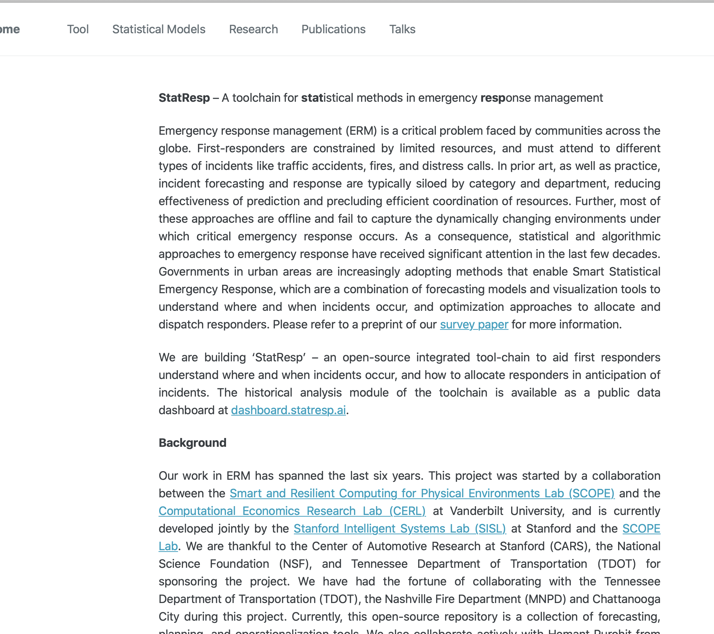
Followup
https://statresp.ai/
Full Papers, Data Dashboards and Presentations are available on the site
Email: hiba.baroud@Vanderbilt.edu or abhishek.dubey@Vanderbilt.edu
Thank you to
Said El Said, John Hall, Ray and Brad Freeze and Others at T-DOT

